Slide 1




Sancai
Reservation System
Online Reservation System for Restaurant
By Xixillia Sunaryo

Slide 2

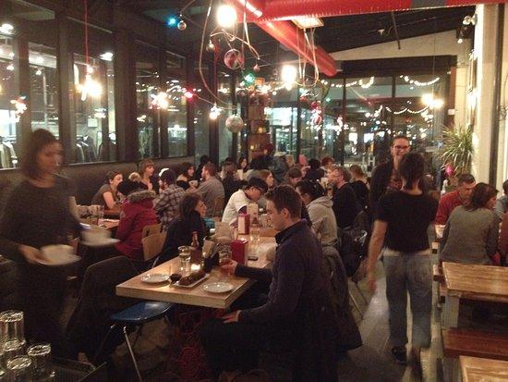
Problem
01
Manual Booking
02
Chat lama dibalas
03
Double Booking
04
Peak Hour Chaos

Slide 3

Customer
Web/API
Solution
Automated • Online • Real-time • Centralized
System
Staff

Slide 4






Main Features
Online Reservations
Table Availability
Menu & Order
Status Reservasi
Secure Auth
(JWT)
API Docs

Slide 5

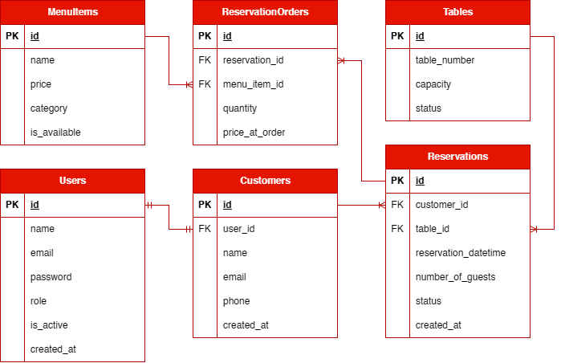
Database (ERD)

Slide 6
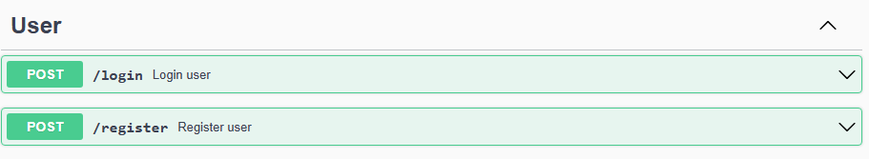
Users API
Flow
Login
JWT
Access API

Slide 7
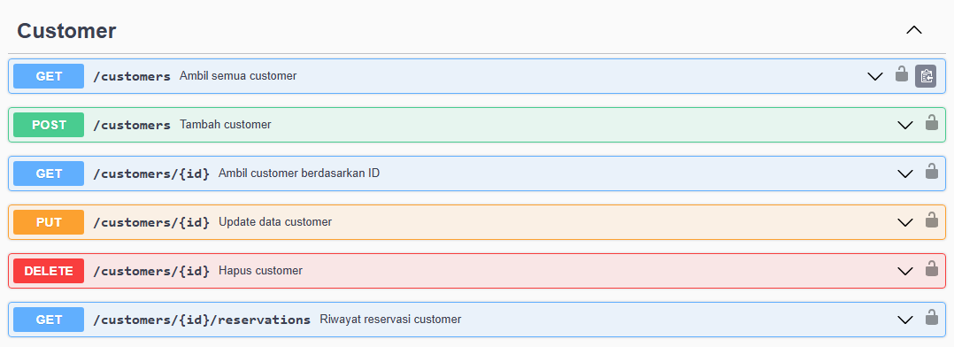
Customers API
Flow
Login
JWT
Access API

Slide 8
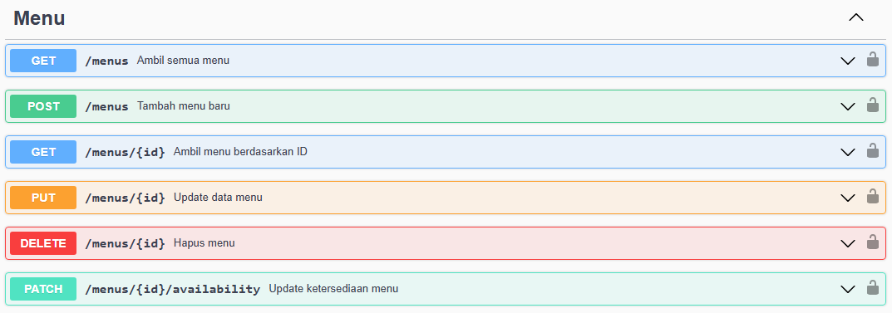
Menus API
Flow
Login
JWT
Access API

Slide 9
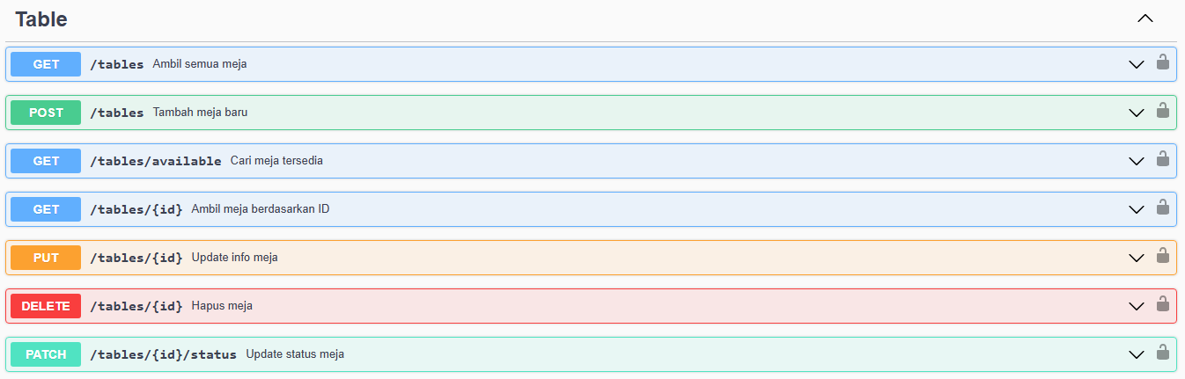
Tables API
Flow
Login
JWT
Access API

Slide 10
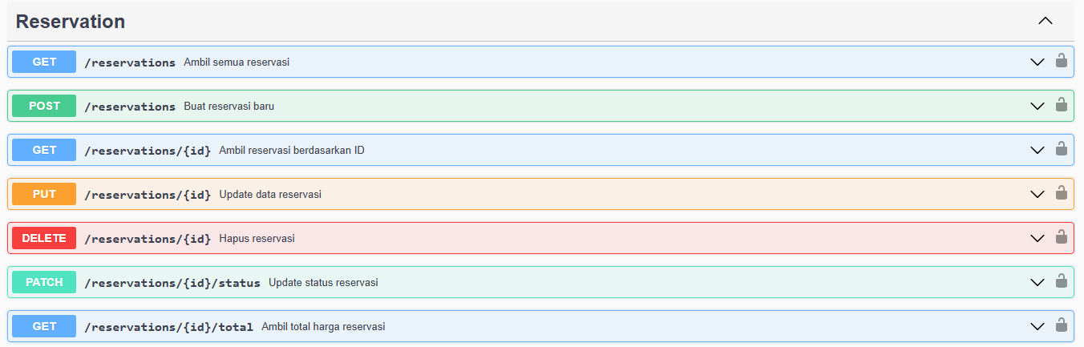
Reservations API
Flow
Login
JWT
Access API

Slide 11
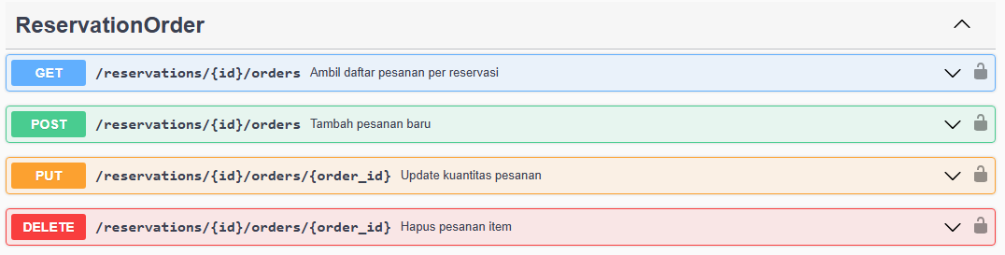
Reservation Orders API
Flow
Login
JWT
Access API

Slide 12
Deployment
Github
Build
Railway
Public API
Database : PostgreSQL

Slide 13

DEMO API

Slide 14
Conclusion
01
02
Future Enhancement
Kesimpulan
Sistem reservasi terpusat dengan API yang aman dan terstruktur
Mempermudah pemesanan pelanggan & operasional restoran
Siap di-deploy dan scalable di production
Dashboard admin & staf
Notifikasi reservasi baru & perubahan status reservasi
Pengaturan jam operasional & hari libur

Slide 15

Thank You
By Xixillia Sunaryo

